Slide 1
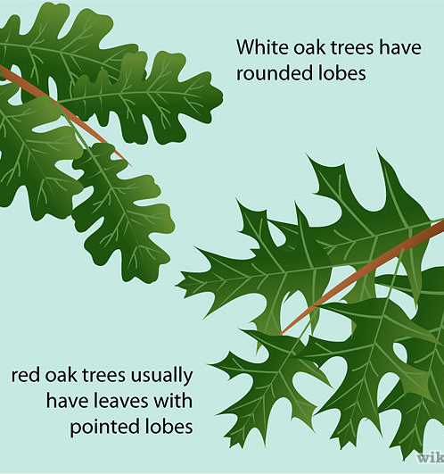
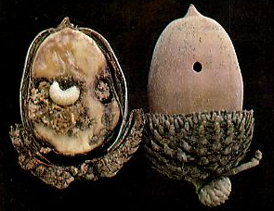
Preview of Where We’re Going
 |  | acorns with…
site | oak.sp | weevils | none
H | red | 584 | 187
H | white | 406 | 74
S | red | 910 | 118
S | white | 308 | 66
V | red | 391 | 101
V | white | 500 | 82
DATA: Prof. Michael Steele, Wilkes University, http://www.wilkes.edu/pages/969.asp?pidm=6010
Does the proportion of weevils differ significantly (more than expected by chance) by oak species, site, or both and by how much?
glm(cbind(weevils, non) ~ oak.sp + site, …) (plus several other tools)

Slide 2
Sampling Variation
If you repeat an experiment many times under identical conditions, you will get slightly different results.
E.g. sampling from a binomial distribution—number of events will differ in each random sample.
Fundamental problem in statistics: How do we know if variation in outcomes is just sampling variation or if there are real differences among groups?
In other words, are samples drawn from the same population (defined by some parameters) or different populations?

Slide 3
Exercise
We will compare two samples and use likelihood ratios to evaluate whether the probability of an event differs among the two samples.
Two models:
Model 1: The probability of an event differs between the two samples (they are from different populations)
Model 2: The probability of an event is the same in both samples (they come from the same population)
Case 1: Does the proportion of [color 1] skittles differ between two bags?
Case 2: Does the proportion of [color 1] and [color 2] differ within one bag?

Slide 4
Class Data
Enter your data on communal google sheet
Calculate a MLE for both samples combined (model 1) and for each sample separately (model 2).
Use these MLEs of p to get log-likelihood of the whole dataset (both samples) for both models.
Calculate a likelihood ratio (difference in log-likelihoods): ln(L2) – ln(L1)
Note which model has higher likelihood.

Slide 5
Data analysis (in R)
Try your hand at the following:
Read in the class data (export to csv or try using the googlesheets4 package)
Make a histogram of the number of events using either hist() or ggplot2 with geom_histogram()
Get rid of NAs with filter(!is.na(<column_name>))
Make a histogram of the difference in log-likelihoods
Hint: At some point you might want to change the column names to something “friendlier”. Change by hand in csv, with dplyr::rename() or try automatic cleaning with janitor::clean_names().
Notes:
Discuss interpretation of histogram (more complex model always has higher likelihood. Intuitive because in more complex model, p for each sample was the MLE p for each sample).

Slide 6
More facts about likelihood
FACT: For nested models, adding a meaningless predictor variable will always improve the log‐likelihood
nested = one model is a special case of the other, e.g., pooling all acorns vs. dividing acorns by species / one p for both colors vs. p’s for each color
FACT: For non‐nested models, adding a meaningless predictor variable will usually improve the log‐likelihood
non‐nested = one model is not a special case of the other, e.g., classifying acorns by site vs. classifying by species / p’s for each color vs. p’s for each bag
 |  | acorns with…
site | oak.sp | weevils | none
H | red | 584 | 187
H | white | 406 | 74
S | red | 910 | 118
S | white | 308 | 66
V | red | 391 | 101
V | white | 500 | 82

Slide 7
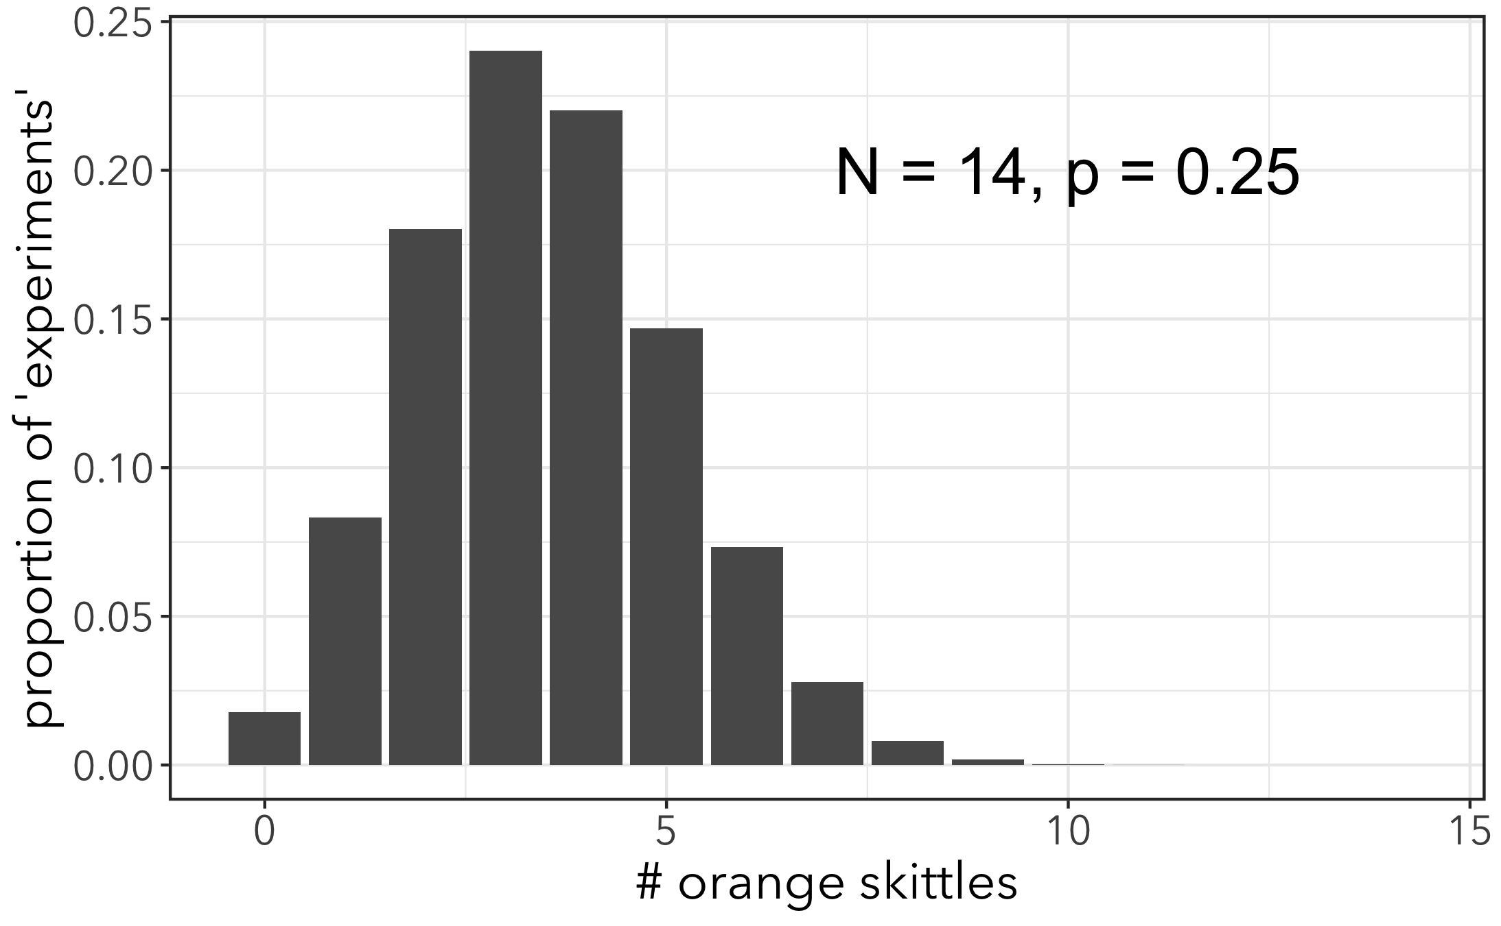
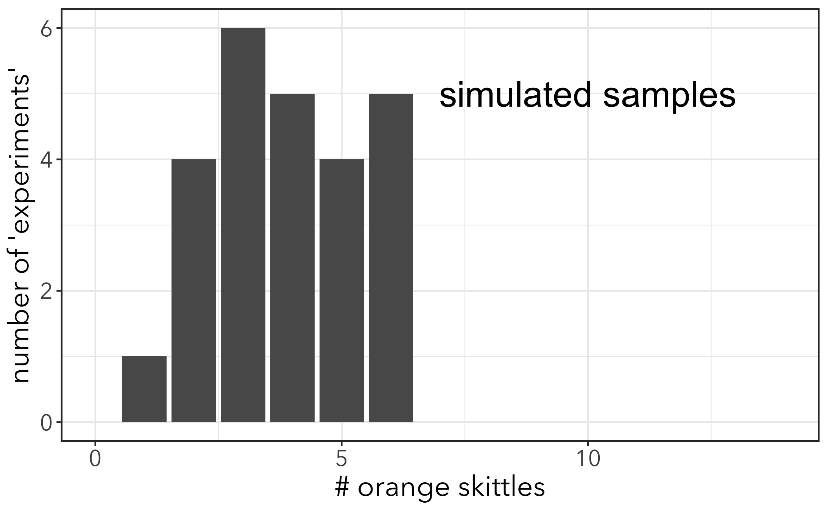
More on Distributions
So far we’ve described distributions with probability density functions (PDF), e.g. dbinom()
For discrete distributions, like the binomial distribution, these are bar graphs where all the bars add up to 1

Slide 8
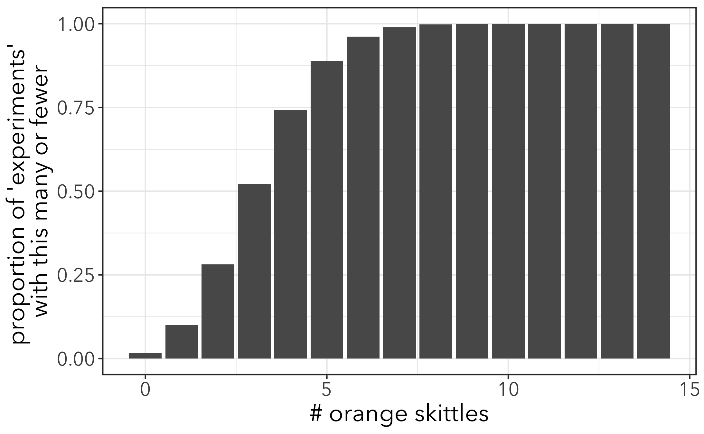
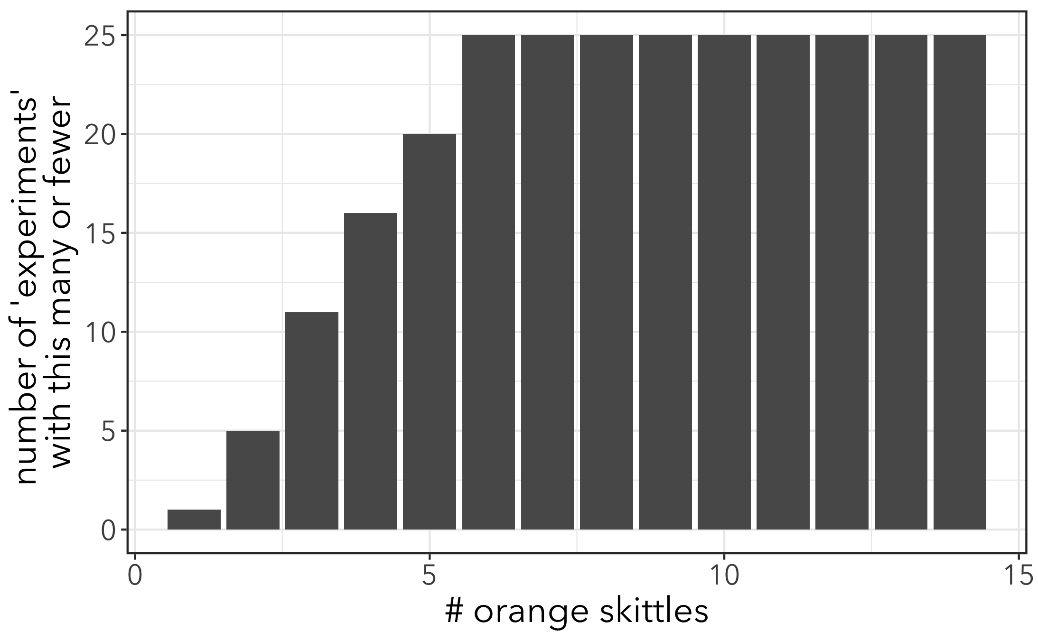
More on Distributions
We can also plot a cumulative distribution function (CDF) for a binomial distribution with pbinom()
Represents probability that an observed value of random variable X is smaller than any particular value of x.
Notes:
For discrete distrubutions like binomial, it’s a cumulative sum of PDF

Slide 9
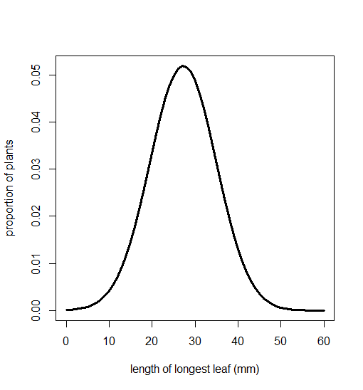
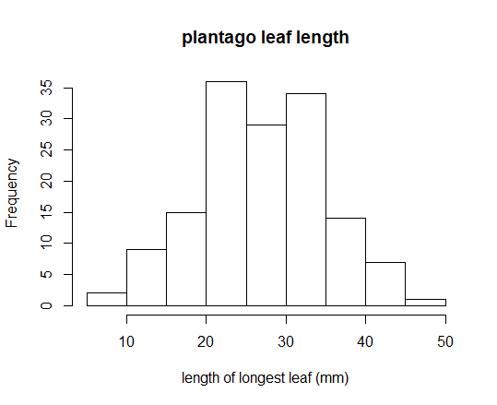

Continuous Distributions
Many random variables are continuous.
PDF for normal distribution with dnorm(x, mean, sd)
mean = 27.2
variance = 59.0
Any particular value of x = 0
Notes:
Any particular value of x = 0!

Slide 10
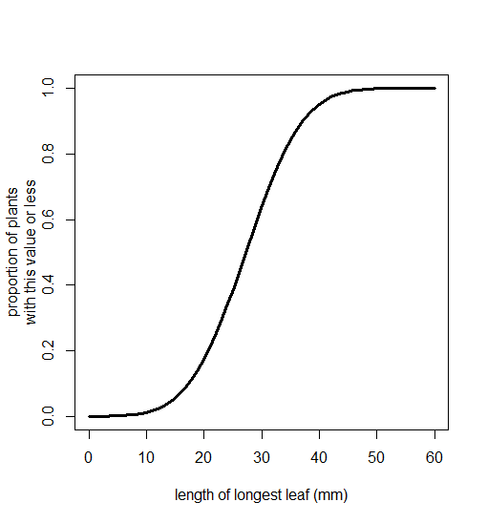
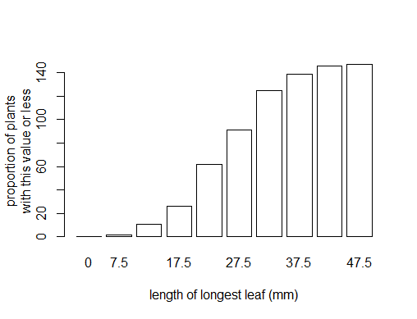
Normal cumulative density function (CDF)
pnorm()
mean = 27.2
variance = 59.0

Slide 11
If you want to know what proportion of outcomes are less than a certain value, CDF is very useful
E.g. 95% of trials expected to have fewer than 6 skittles

Slide 12
If you want to know what proportion of outcomes are less than a certain value, CDF is very useful
E.g. 95% of leaves expected to be < 40mm long

Slide 13
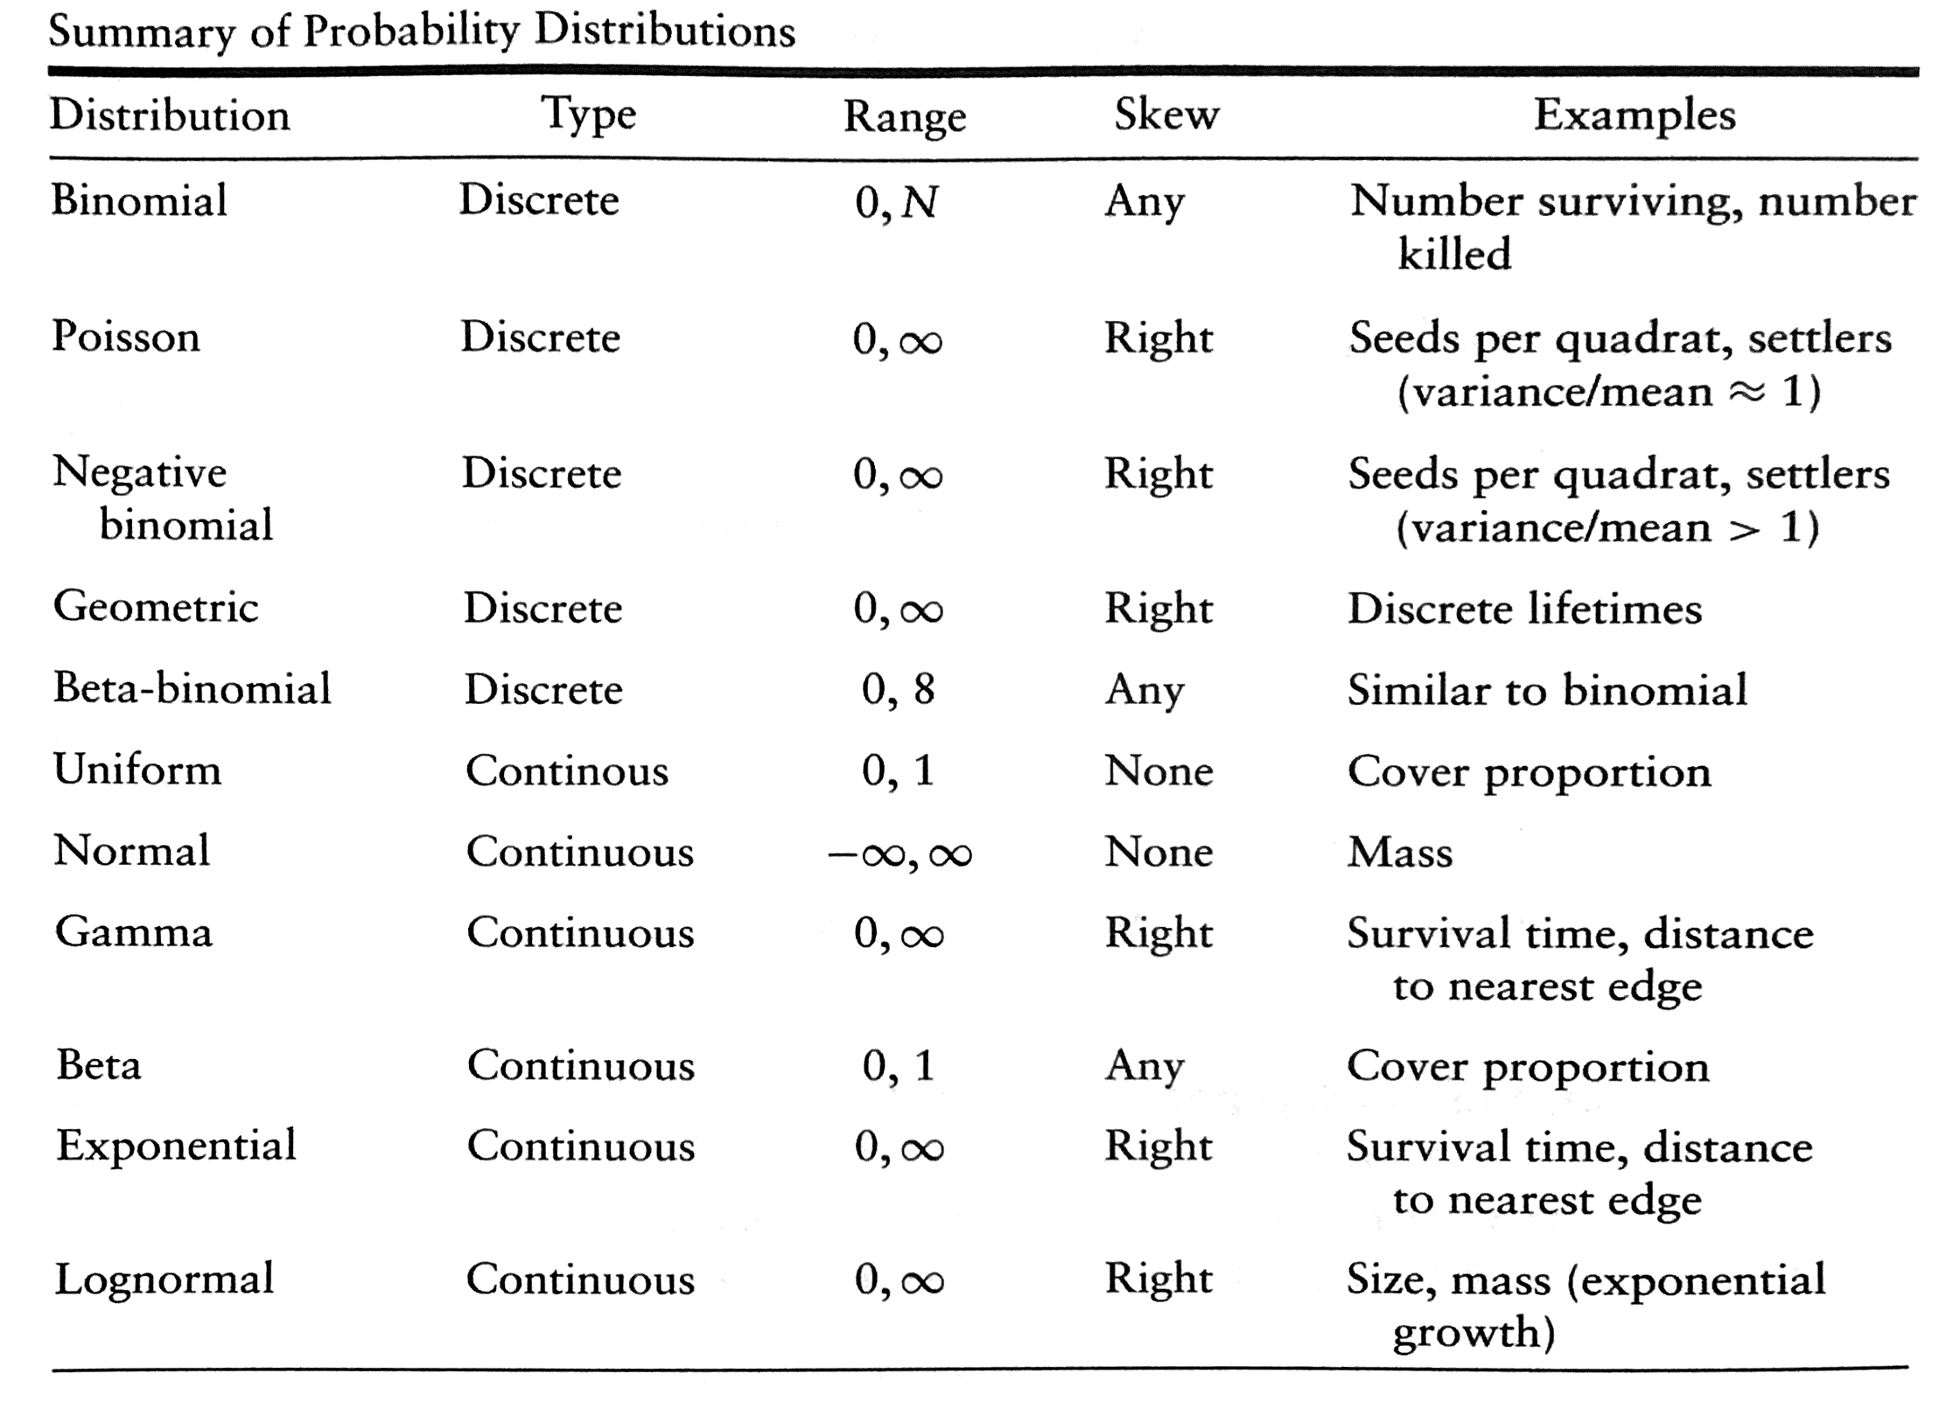
B. Bolker, 2008, Ecological Models and Data in R, Princeton University Press

Slide 14
Intro to Inference
With real data, we never know the true value of the population and can’t do repeated sampling
How do we know if a predictor variable is meaningful? I.e., is there a real difference between proportions of different colored skittles, or is log-likelihood just improved by added another parameter?
Two tools:
Likelihood Ratio Test
Information criterion → AIC: “Akaike’s Information Criterion” or “An Information Criterion”

Slide 15

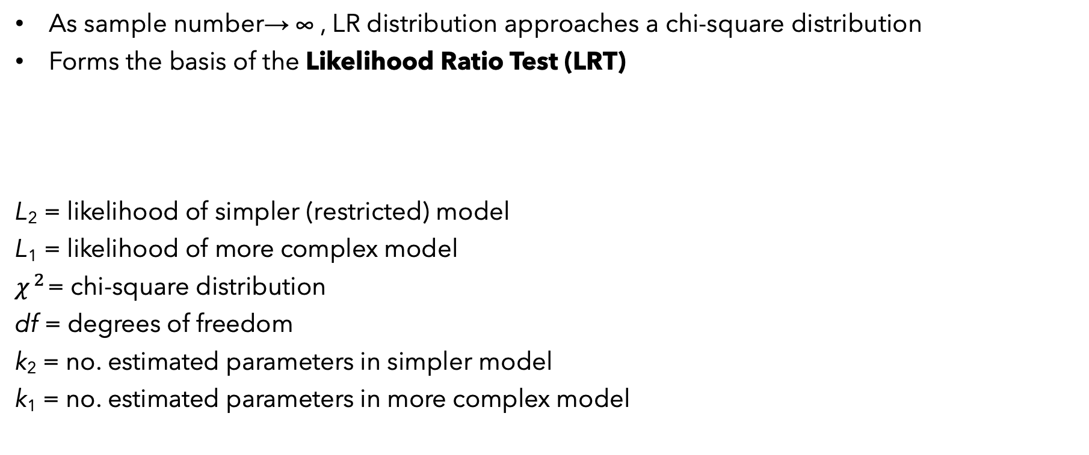
LR follows a continuous distribution
As sample number→ ∞ , LR distribution approaches a chi-square distribution
Forms the basis of the Likelihood Ratio Test (LRT)
L₂ = likelihood of simpler (restricted) model
L₁ = likelihood of more complex model
$χ^{2}$= chi-square distribution
df = degrees of freedom
k₂ = no. estimated parameters in simpler model
k₁ = no. estimated parameters in more complex model
$$−2\ln\left(\frac{L_{2}}{L_{1}}\right)\sim {χ^{2}}_{df= k_{1}−k_{2}}$$

Slide 16
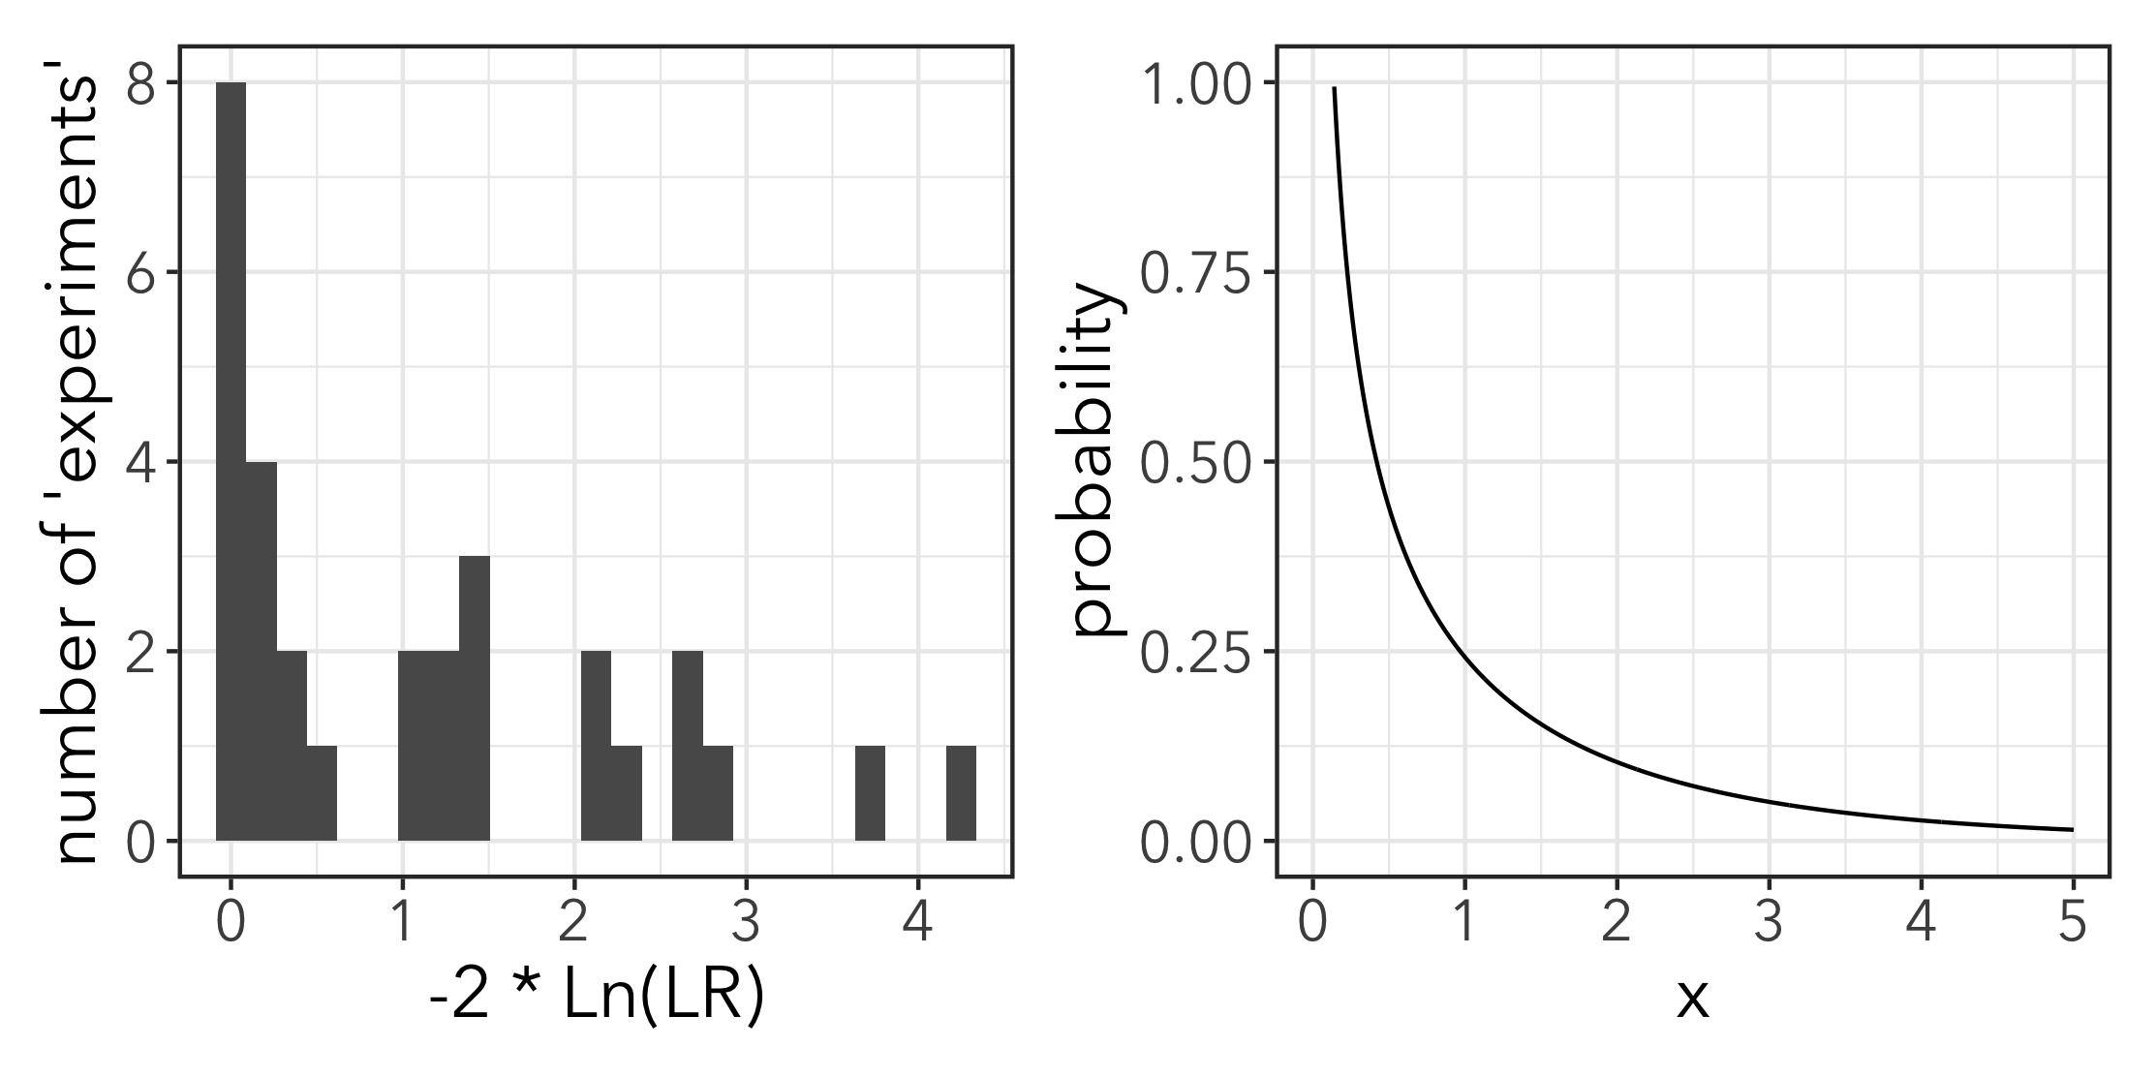
Under null condition, we expect most values of -2*Ln(LR) to be between 0 and 1. More rarely higher values. BTW: use dchisq(x, df) to get PDF for chi-square distribution
Last year’s data for case 1
Chi-square pdf with df = 1

Slide 17
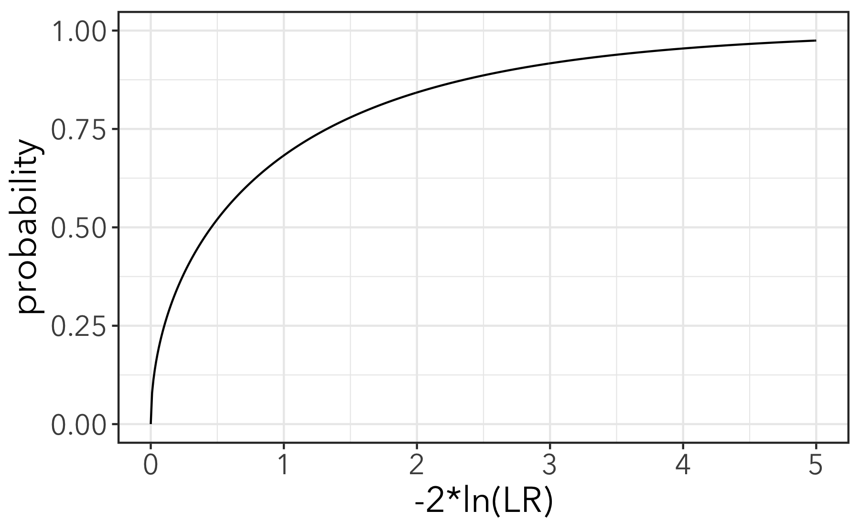
CDF for chi-square distribution with pchisq(x, df)
Expected improvement in likelihood with an ”arbitrary” parameter

Slide 18
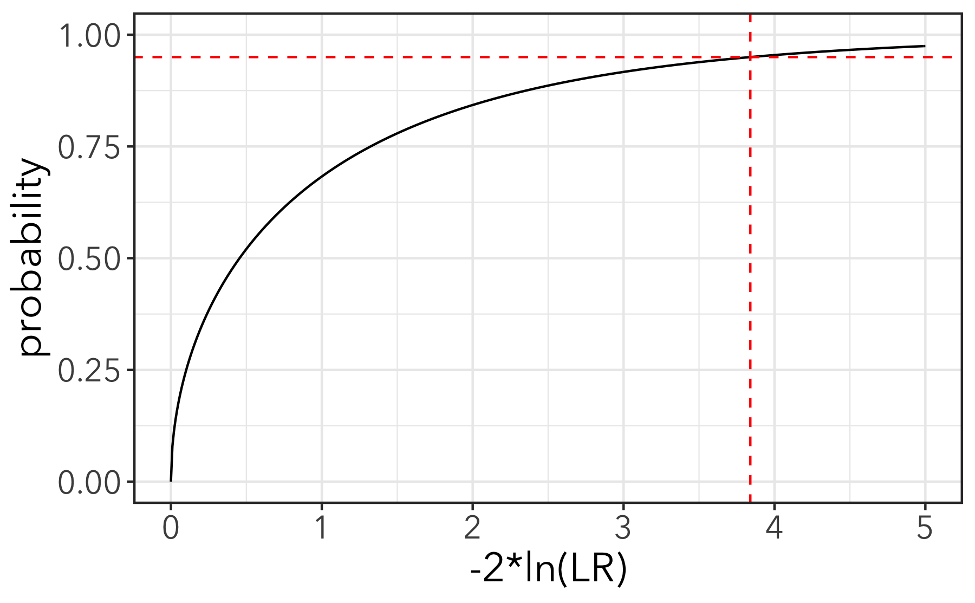
Under the null expectation, 95% of experiments will have -2*LR ≤ 3.84
More complex model is considered “significantly” better with p < 0.05
In other words: if the improvement in likelihood would happen less than 5% of the time with an arbitrary parameter, then the parameter ”significantly” improves the model.

Slide 19
If you add 1 parameter, you reach this 5% significance at -2*ln(LR) = 3.84
qchisq(0.05, df = 1, lower.tail = FALSE)
To get a p-value for a particular value of -2*ln(LR), plug it into pchisq()
pchisq(3.84, df = 1, lower.tail = FALSE)

Slide 20
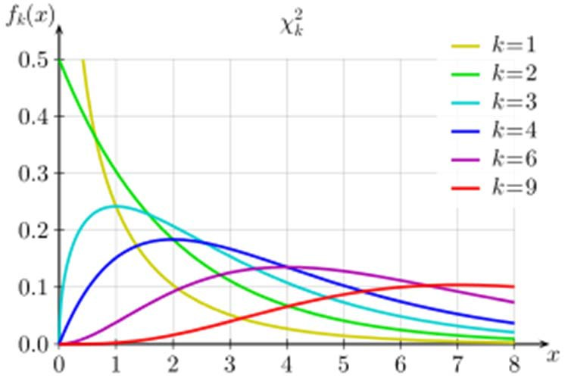
Other chi-square distributions
Different numbers of parameters added (e.g. 3 different colored skittles instead of two) = different degrees of freedom
More df, chi-square starts to look more symmetrical.
As you add more parameters, you expect a bigger improvement in likelihood

Slide 21
Using the LRT
Only for nested models. LR is L(“reduced” model) / L(more complex)
Must be fit to same data set
Compare one pair of models at a time
Retain more complex model if p < 0.05
That is, the probability that an added parameter is improving the likelihood just because it’s an arbitrary parameter is < 5%
In R you could calculate -2Ln(LR) and use pchisq() to get a p-value
More commonly, you can fit two models with glm() and do the LRT with lrtest() from the lmtest package.

Slide 22
To R!
Let’s now treat the class data as a single dataset and use glm() and lrtest() to see if there is a difference in proportion of green and purple skittles!

Slide 23
Akaike’s Information Criterion (AIC)
For non-nested models adding an arbitrary parameter usually improves likelihood
AIC allows comparison of non-nested models
Rather than using hypothesis testing with a distribution, AIC adds a penalty to the -2 * Ln(LR) quantity (sometimes called “deviation”)

Slide 24
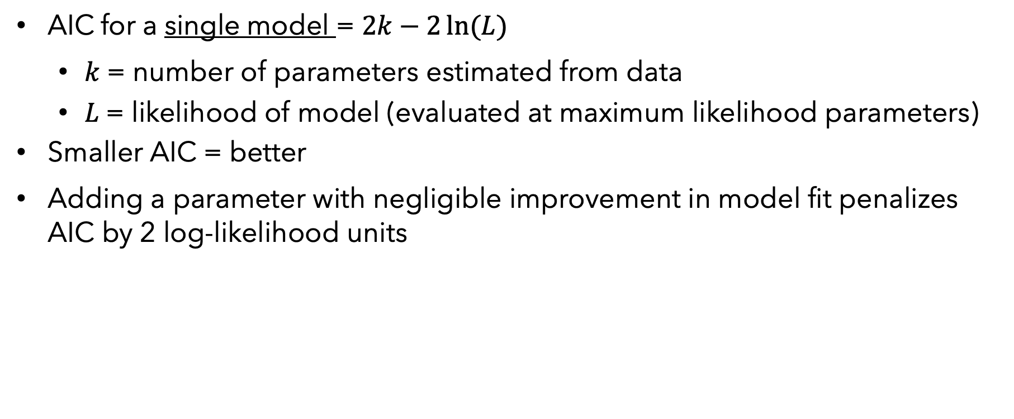
Akaike’s Information Criterion (AIC)
AIC for a single model = $2k−2\ln{(L)}$
$k$ = number of parameters estimated from data
$L$ = likelihood of model (evaluated at maximum likelihood parameters)
Smaller AIC = better
Adding a parameter with negligible improvement in model fit penalizes AIC by 2 log-likelihood units

Slide 25
Using AIC
Calculate AIC for all models of interest (nested or non-nested) fit to the same data set.
Compare relative support for two or more models
Model with lowest AIC “wins”
Models within 2 of lowers AIC should not be discarded
Report difference from best model in a set as ∆AIC

Slide 26
Calculate AIC and ∆AIC for skittles models
As an alternative to a LRT, use ∆AIC to determine which model fits data better: same proportion, or different proportions by bags/colors
AIC = 2*k – 2(log-likelihood)
What is “k” for the first model that has different values of “p” for each color?
What is “k” for the second model?

Slide 27
R Code to calculate AIC
colors <- colors_raw %>%
clean_names() %>%
#AIC = 2*k – 2(log-lik)
mutate(AIC1 = 2*2 - 2*log_l1_sum,
AIC2 = 1*2 - 2*log_l2_sum,
dAIC = AIC2 - AIC1) %>%
filter(!is.na(dAIC))

Slide 28
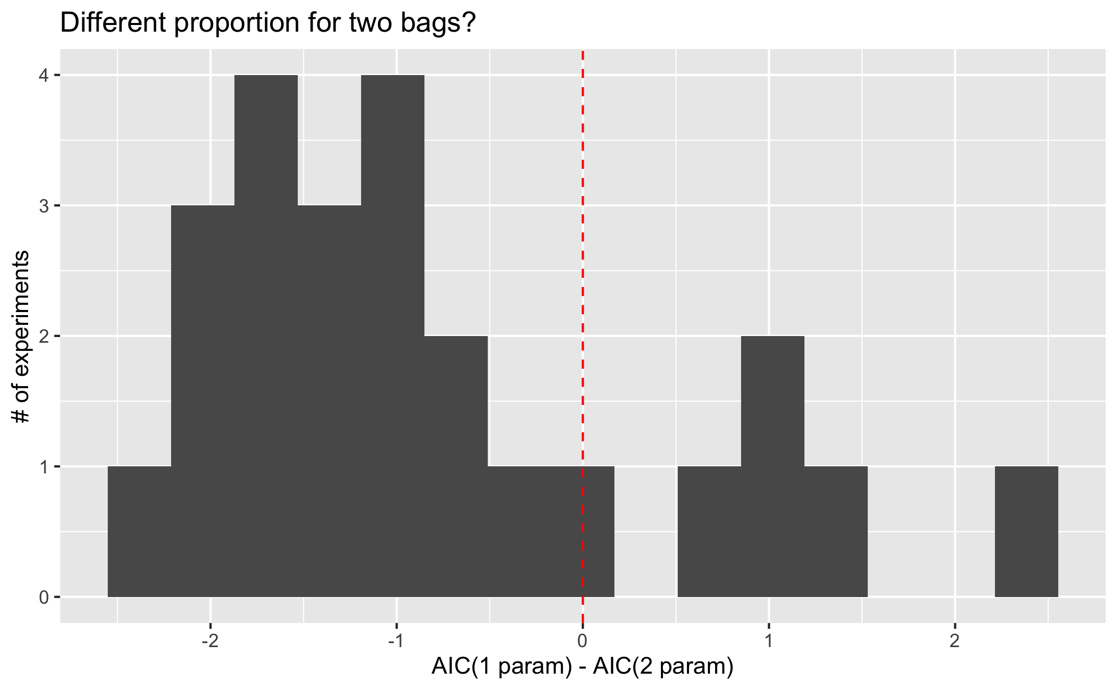
1 parameter model
“wins”
(lower AIC)
2 parameter model
“wins”
(lower AIC)

Slide 29
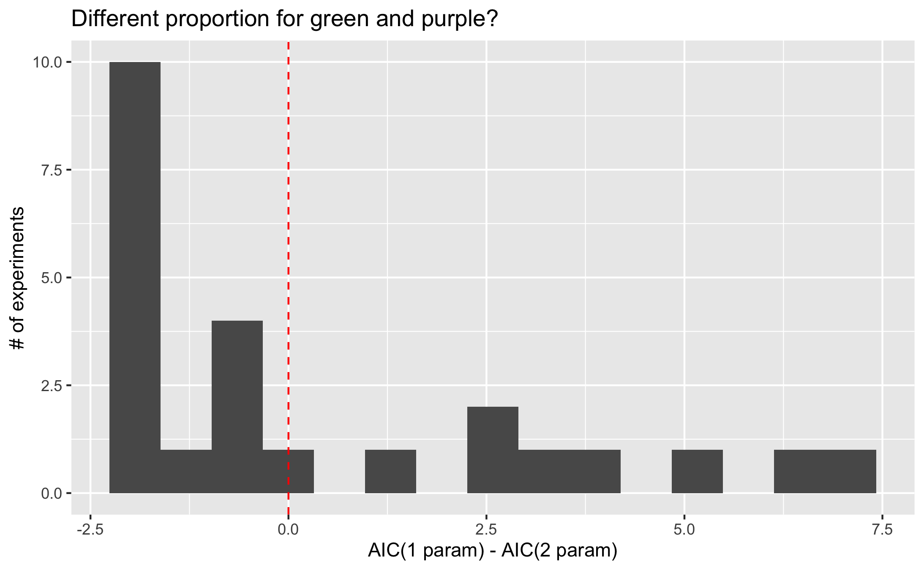
1 parameter model
“wins”
(lower AIC)
2 parameter model
“wins”
(lower AIC)

Slide 30
Back to Oaks
Calculate a log-likelihood for the data
Assuming a single p for the whole dataset
Assuming different p for each site (ignoring oak species)
Assuming different p for each species (ignoring site)
Use a LRT to see if estimating different p for each species or for each site improves model significantly
Use AIC to see which of the three models best fits the data
 |  | acorns with…
site | oak.sp | weevils | none
H | red | 584 | 187
H | white | 406 | 74
S | red | 910 | 118
S | white | 308 | 66
V | red | 391 | 101
V | white | 500 | 82
DATA: Prof. Michael Steele, Wilkes University, http://www.wilkes.edu/pages/969.asp?pidm=6010

